Slide 1
Data Science
Noble Xavier

Slide 2
DEFINITION/OVERVIEW

Slide 3
Definition
Data science uses statistics, scientific computing, scientific methods, processes, algorithms and systems to extract or extrapolate knowledge and insights from noisy, structured, and unstructured data.
Data science is the study of data. Like biological sciences is a study of biology
Data science is a field that involves using scientific methods, processes, algorithms, and systems to extract knowledge and insights from structured and unstructured data. It can be used in a variety of industries and applications such as Business, Healthcare, Finance, Social Media and Natural Language Processing

Slide 4
Definition

Slide 5
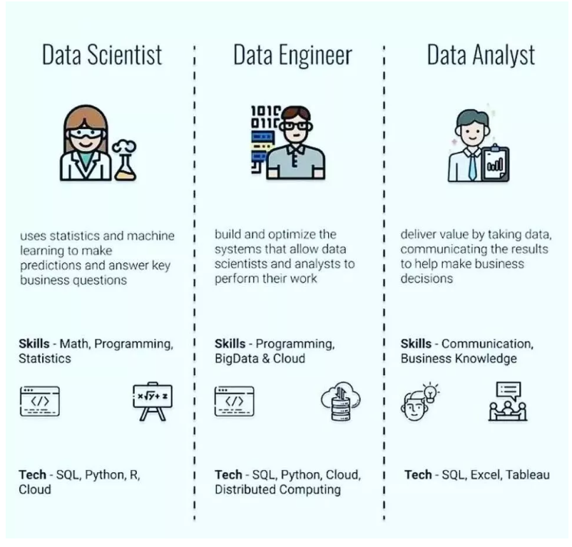

Slide 6
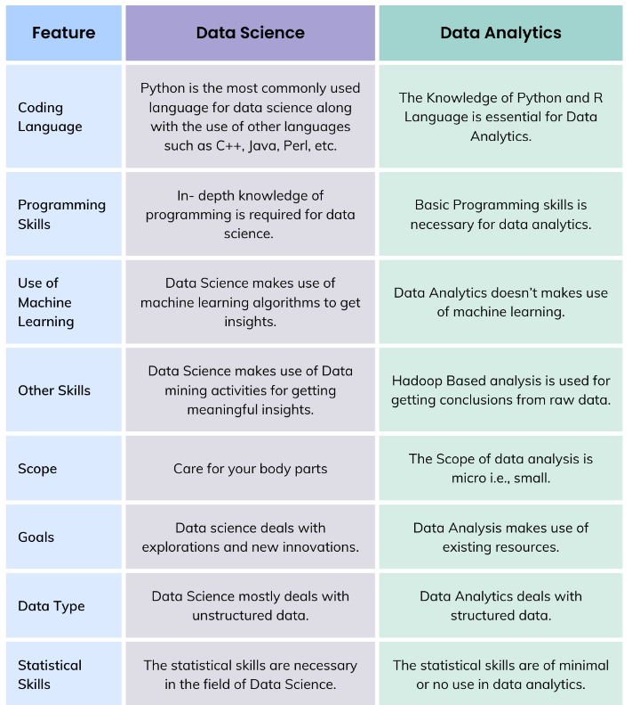

Slide 7
IMPORTANCE OF DATA SCIENCE

Slide 8
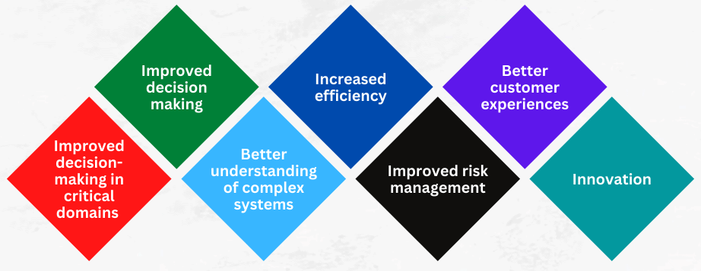
Importance Of Data Science

Slide 9
Importance Of Data Science
Improved decision-making in critical domains: In critical domains such as healthcare, criminal justice, and finance, data science can help in decision-making by analyzing relevant data to produce evidence-based outcomes, reducing bias, and improving fairness.
Improved decision-making: DS provides organizations with a systematic way to analyze data and make informed decisions. By using data to inform decision-making, organizations can make better, more informed decisions that drive growth and success.
A better understanding of complex systems: DS can be used to analyze complex systems, such as the human body, the global economy, or the environment, to gain a deeper understanding of these systems and identify ways to improve them.
Increased efficiency: DS can be used to optimize operations, reduce waste, and improve efficiency. By using data to identify inefficiencies and areas for improvement, organizations can streamline their operations and increase their competitiveness.

Slide 10
Importance Of Data Science
Improved risk management: DS can be used to analyze risk and uncertainty, such as fraud and cyber threats, to improve risk management and minimize potential losses.
Better customer experiences: DS can be used to analyze customer data, such as purchase history and behavior, to personalize marketing campaigns and improve customer experiences. This can help organizations increase customer satisfaction and loyalty.
Innovation: DS can be used to identify new opportunities for growth and innovation. By analyzing data, organizations can identify new market trends, customer needs, and areas for innovation, and develop new products and services to meet these needs.

Slide 11
JOB ROLE AND SCOPE OF DATA SCIENCE

Slide 12
Job Roles
Data Analyst: The Data analyst is responsible for analyzing data utilizing data analysis tools and assisting their teams in developing insights and business plans.
Data Engineer: The Data Engineer’s purpose is to offer an orderly, uniform data flow that enables data-driven models like machine learning models and data analysis.
Machine Learning Engineer: Working as a machine learning engineer, you’ll be in charge of developing models and algorithms that allow machines to function automatically.
Marketing Analyst: A marketing analyst does research to determine what customers need and desire, as well as assess the efficiency of a company’s marketing and commercial strategy.

Slide 13
Job Roles
Data Scientist (Junior Data Scientist): Work with the manager through the entire analytical and machine learning model life cycle
Associate data scientist: responsible for assisting the data science team in various tasks related to data analysis, machine learning, and data-driven decision-making.
Data Scientist (senior-level): The Senior Data Scientist oversees the activities of the junior data scientists and provides advanced expertise on statistical and mathematical concepts for the broader Data and Analytics department

Slide 14
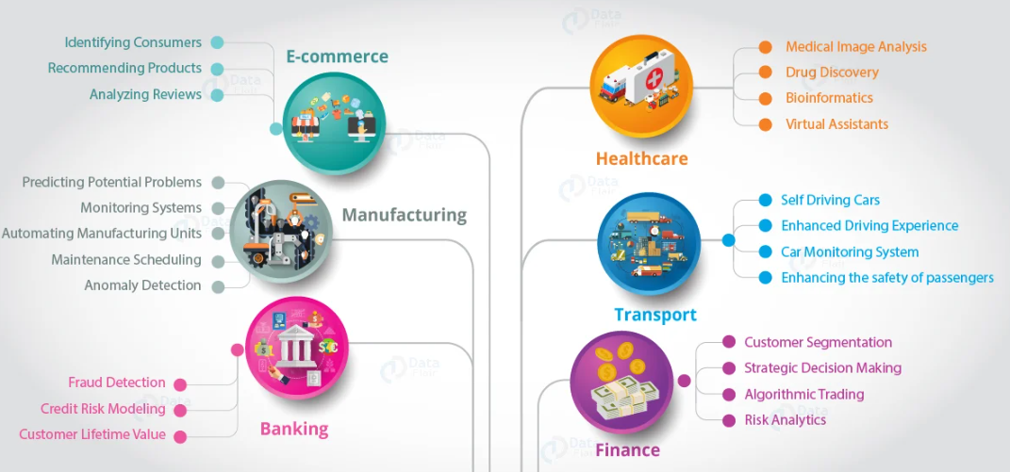
Scope

Slide 15
HISTORY AND FUTURE

Slide 16
Evolution
1962– John W Tukey (Future of Data Analysis)
1966-1977 -SAS University North Carolina
1991- Python
Guido Van Rossum
1991-1993 R
Ross Ihaka, Robert Gentlemen
Early 2000 SAS –Social Media Analytics
2001 –William S Cleveland (Data Science: An action plan for Expanding the Technical Areas in the filed of Statistics)
2007 – Scikits learn
2010 – Mike Loukides (What is data science)

Slide 17
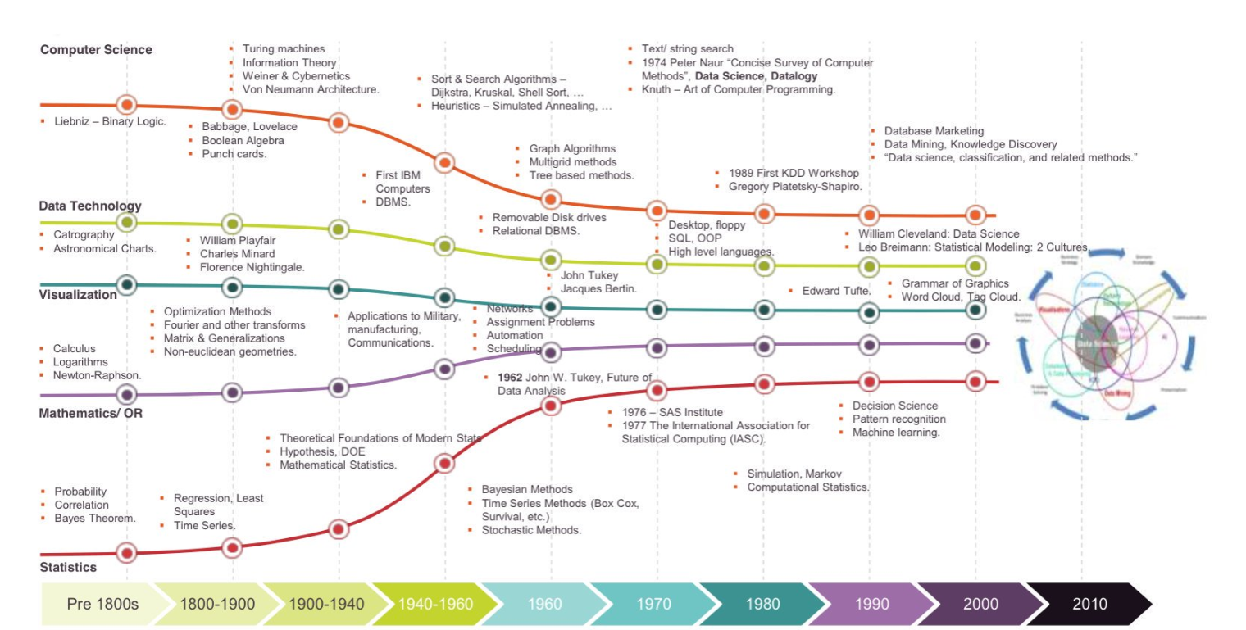

Slide 18
BENEFITS AND CHALLENGES

Slide 19
Benefits Of Data Science
Decision-making: Data scientists are trained professionals who convert unstructured and raw data into deep insights that benefit business organizations. Therefore, data scientist empowers business decisions and helps leaders during complex business scenarios.
Identifying opportunities: Data scientists help businesses identify different work opportunities. They also use data extracted to forecast future market conditions that help business makes fundamental changes and prepare for adversities.
Automating different processes: Data scientists are trained professionals who change the central operating system of the business organization by introducing automation and modern technologies like artificial intelligence, machine learning, and deep learning.
Reduces risks: Data scientist helps make data-driven business decision that reduces the risks of failure

Slide 20
Benefits Of Data Science
Predictive Analytics: Use data science when you want to forecast future trends, identify patterns, and make data-driven predictions to inform decision-making processes.
Optimizing Processes: Apply data science to improve efficiency, streamline operations, and minimize costs by analyzing data from various sources and identifying areas for improvement.
Customer Segmentation: Use data science to analyze customer data, identify distinct groups with similar characteristics, and develop targeted marketing strategies to better serve each segment.
Anomaly Detection
Apply data science to detect unusual patterns, identify outliers, and monitor performance metrics, enabling timely intervention and proactive problem-solving.

Slide 21
Challenges of Data Science
Recognizing the issue with data: One of the biggest difficulties in data science is identifying the issue or problem. Data scientists generally start with an enormous dataset that must be structured. They must understand what they can do with the data.
Accessing the best suitable information: Since companies generate huge quantities of data per second, finding the correct data to analyze is difficult.
A lack of skilled workers: As more and more businesses are becoming reliant on data science; as a result, the need for high experts in data science is growing.
Data Cleansing: Data cleansing, or removing unneeded data from a collection, is one of the most pressing issues in data science. It has been reported that businesses are losing nearly 25 percent of earnings since cleaning data that is not clean is expensive.

Slide 22
LIFE CYCLE OF DATA SCIENCE

Slide 23
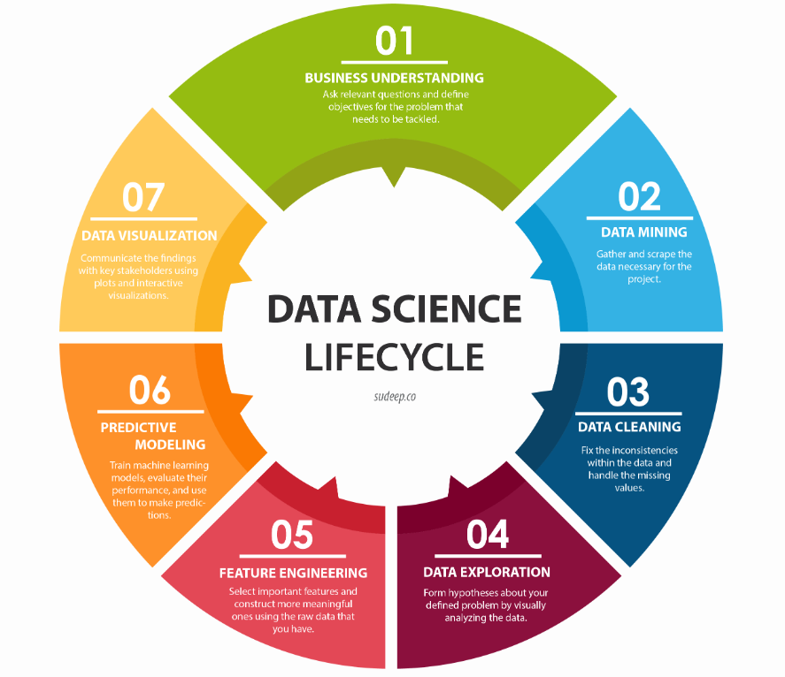
Life Cycle Of Data Science

Slide 24
Life Cycle Of Data Science
Business Understanding: To ensure that every decision made in the company is supported by concrete data and that it is guaranteed (with a high probability) to achieve results
Data Mining: Data mining is the process of gathering data from different sources. Some people tend to group data retrieval and cleaning together.
Data Cleaning: Data cleaning is the process of fixing or removing incorrect, corrupted, incorrectly formatted, duplicate, or incomplete data within a dataset. When combining multiple data sources, there are many opportunities for data to be duplicated or mislabeled.
Data Exploration: Data exploration is the first step in data analysis involving the use of data visualization tools and statistical techniques to uncover data set characteristics and initial patterns.

Slide 25
Life Cycle Of Data Science
Feature Engineering: Feature engineering refers to manipulation — addition, deletion, combination, mutation — of your data set to improve machine learning model training, leading to better performance and greater accuracy.
Predictive modeling: Predictive modeling is a mathematical process used to predict future events or outcomes by analyzing patterns in a given set of input data
Data visualization: Data visualization is the representation of data through the use of common graphics, such as charts, plots, infographics, and even animations

Slide 26
SALARIES OF DATA SCIENCE ROLES

Slide 27
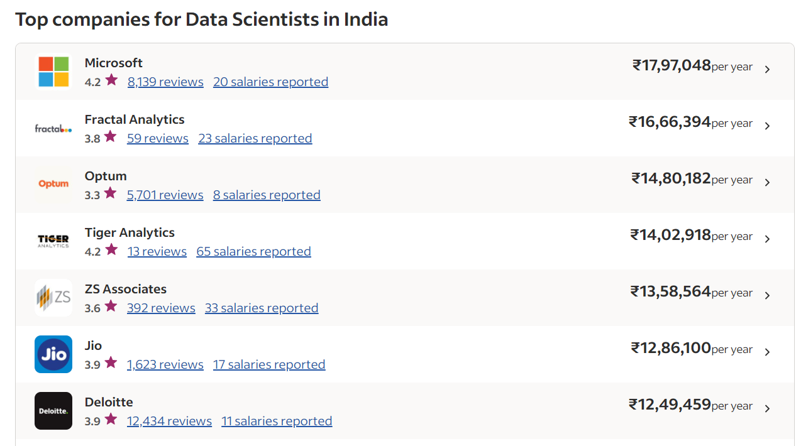
https://www.glassdoor.co.in/Salaries/data-scientist-salary-SRCH_KO0,14.htm

Slide 28
Salary of Data Science
Glassdoor: https://www.glassdoor.co.in/Salaries/data-scientist-salary-SRCH_KO0,14.htm
https://www.ambitionbox.com/profile/data-scientist-salary
https://in.indeed.com/career/data-scientist/salaries

